Slide 1



Slide 2
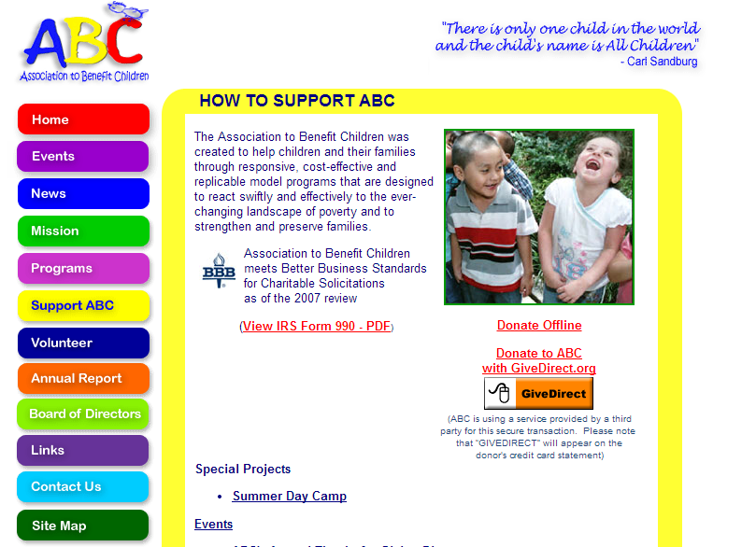

Slide 3


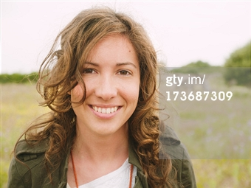
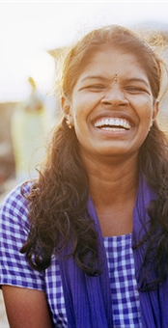

Donors of

Slide 4
Problem
Lack of engagement with the donors

Slide 5
Donated $250,000
Sarah
Thomas
James Thanksgiving
Hazel – Individual Donor

Slide 6
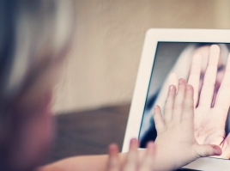
In Touch
A platform where donors and beneficiaries stay connected through video recording of their own lives, thoughts, and comments.

Slide 7

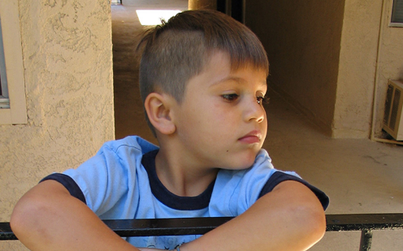
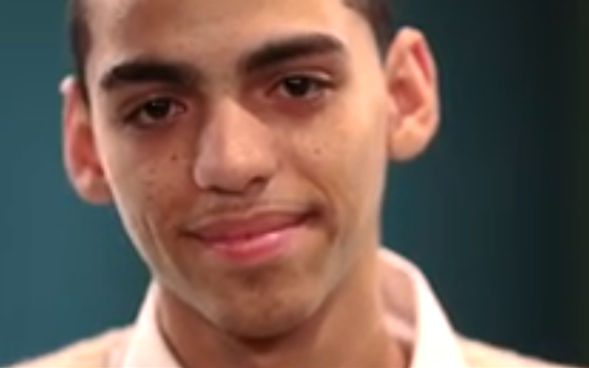
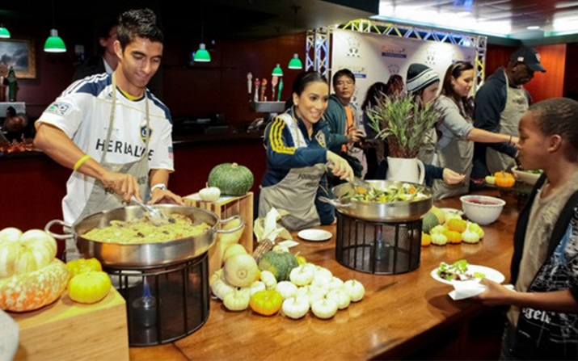
In Touch
Hazel – Individual Donor

Slide 8

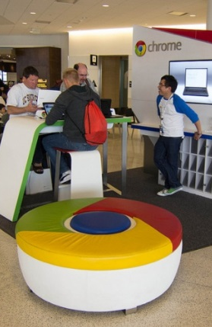
In Touch

Slide 9
In Touch
How does it work?

Slide 10
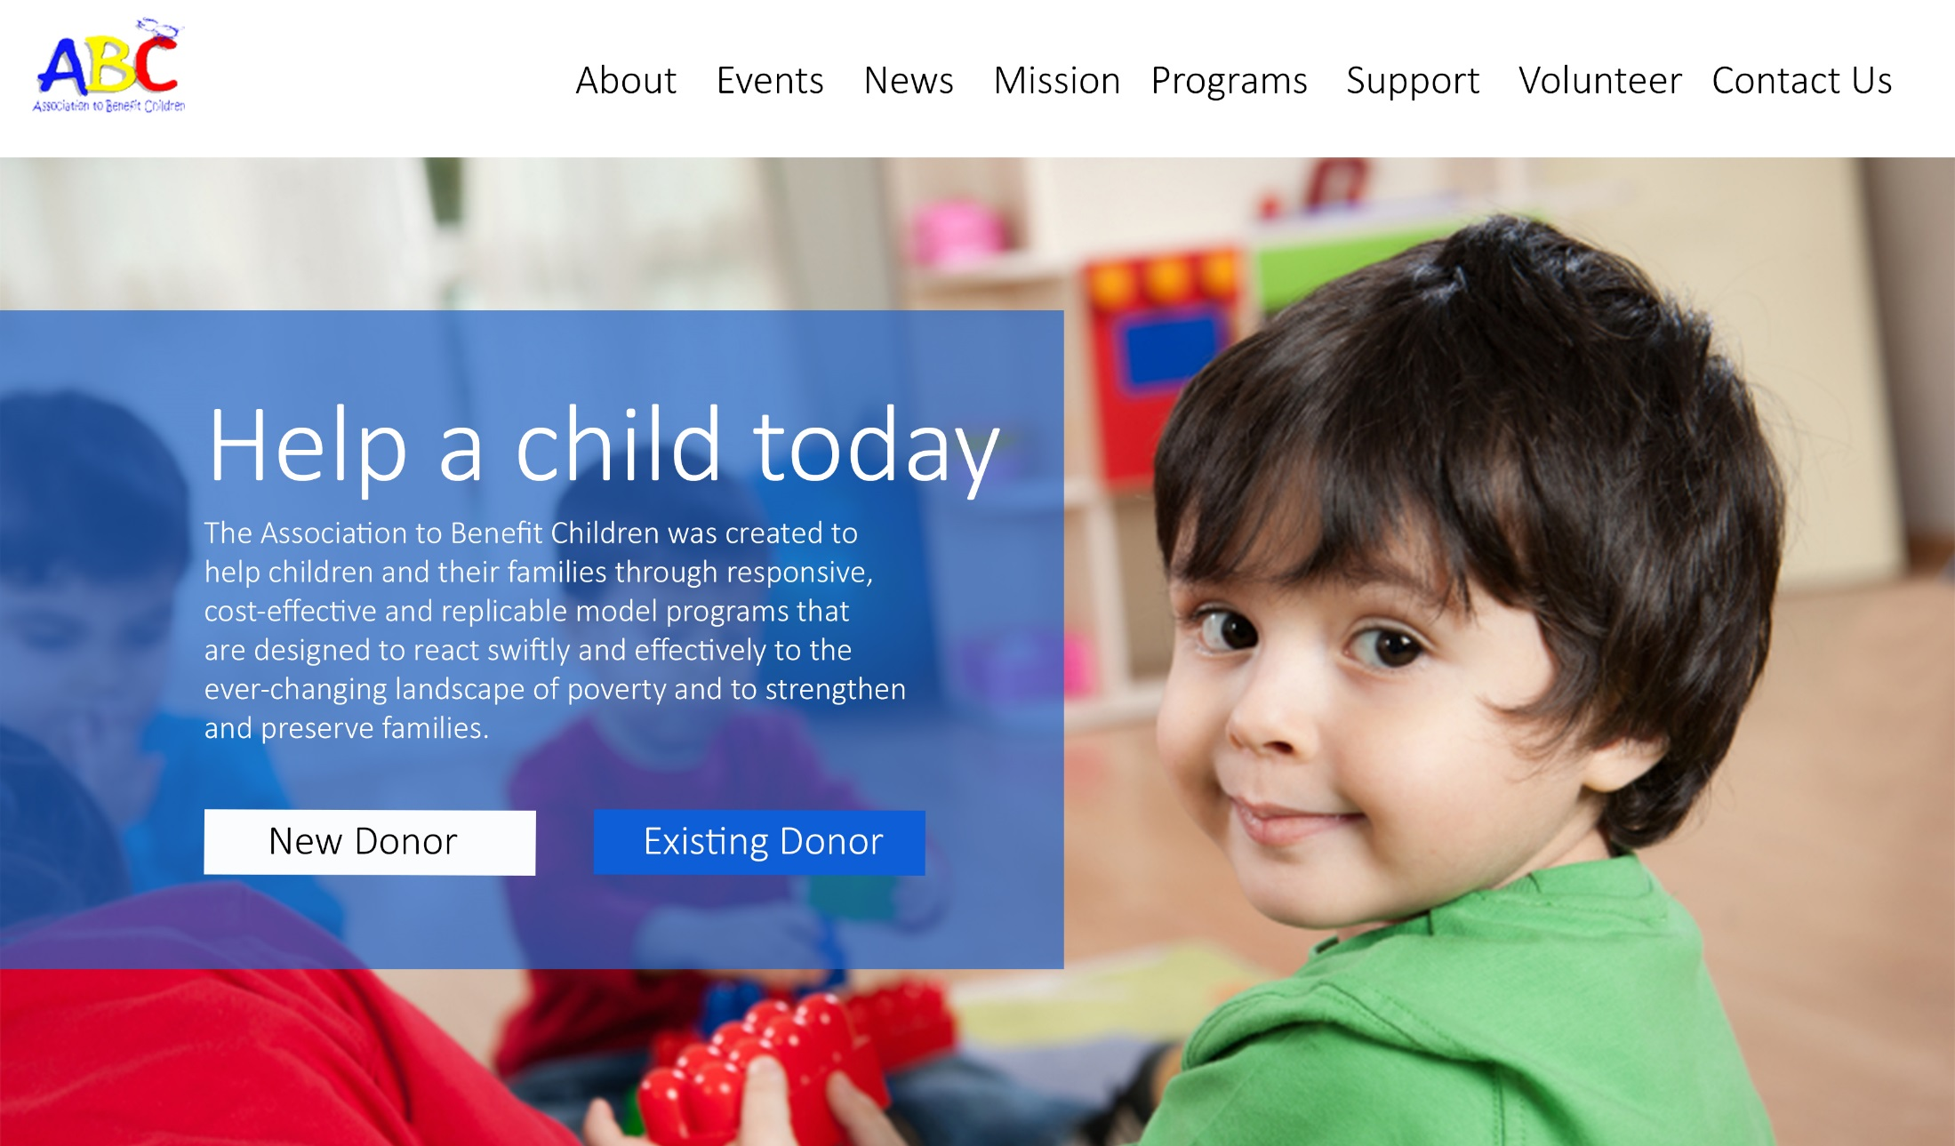

Slide 11
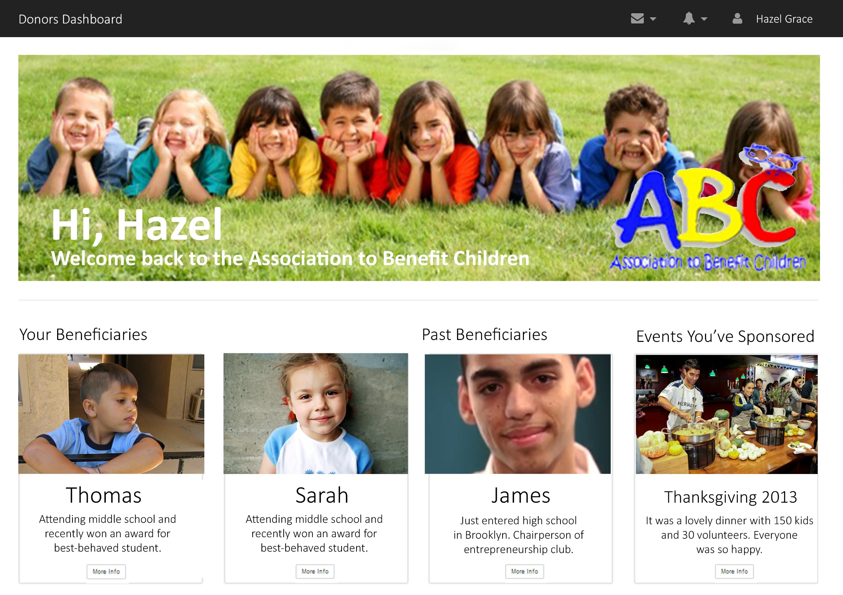

Slide 12
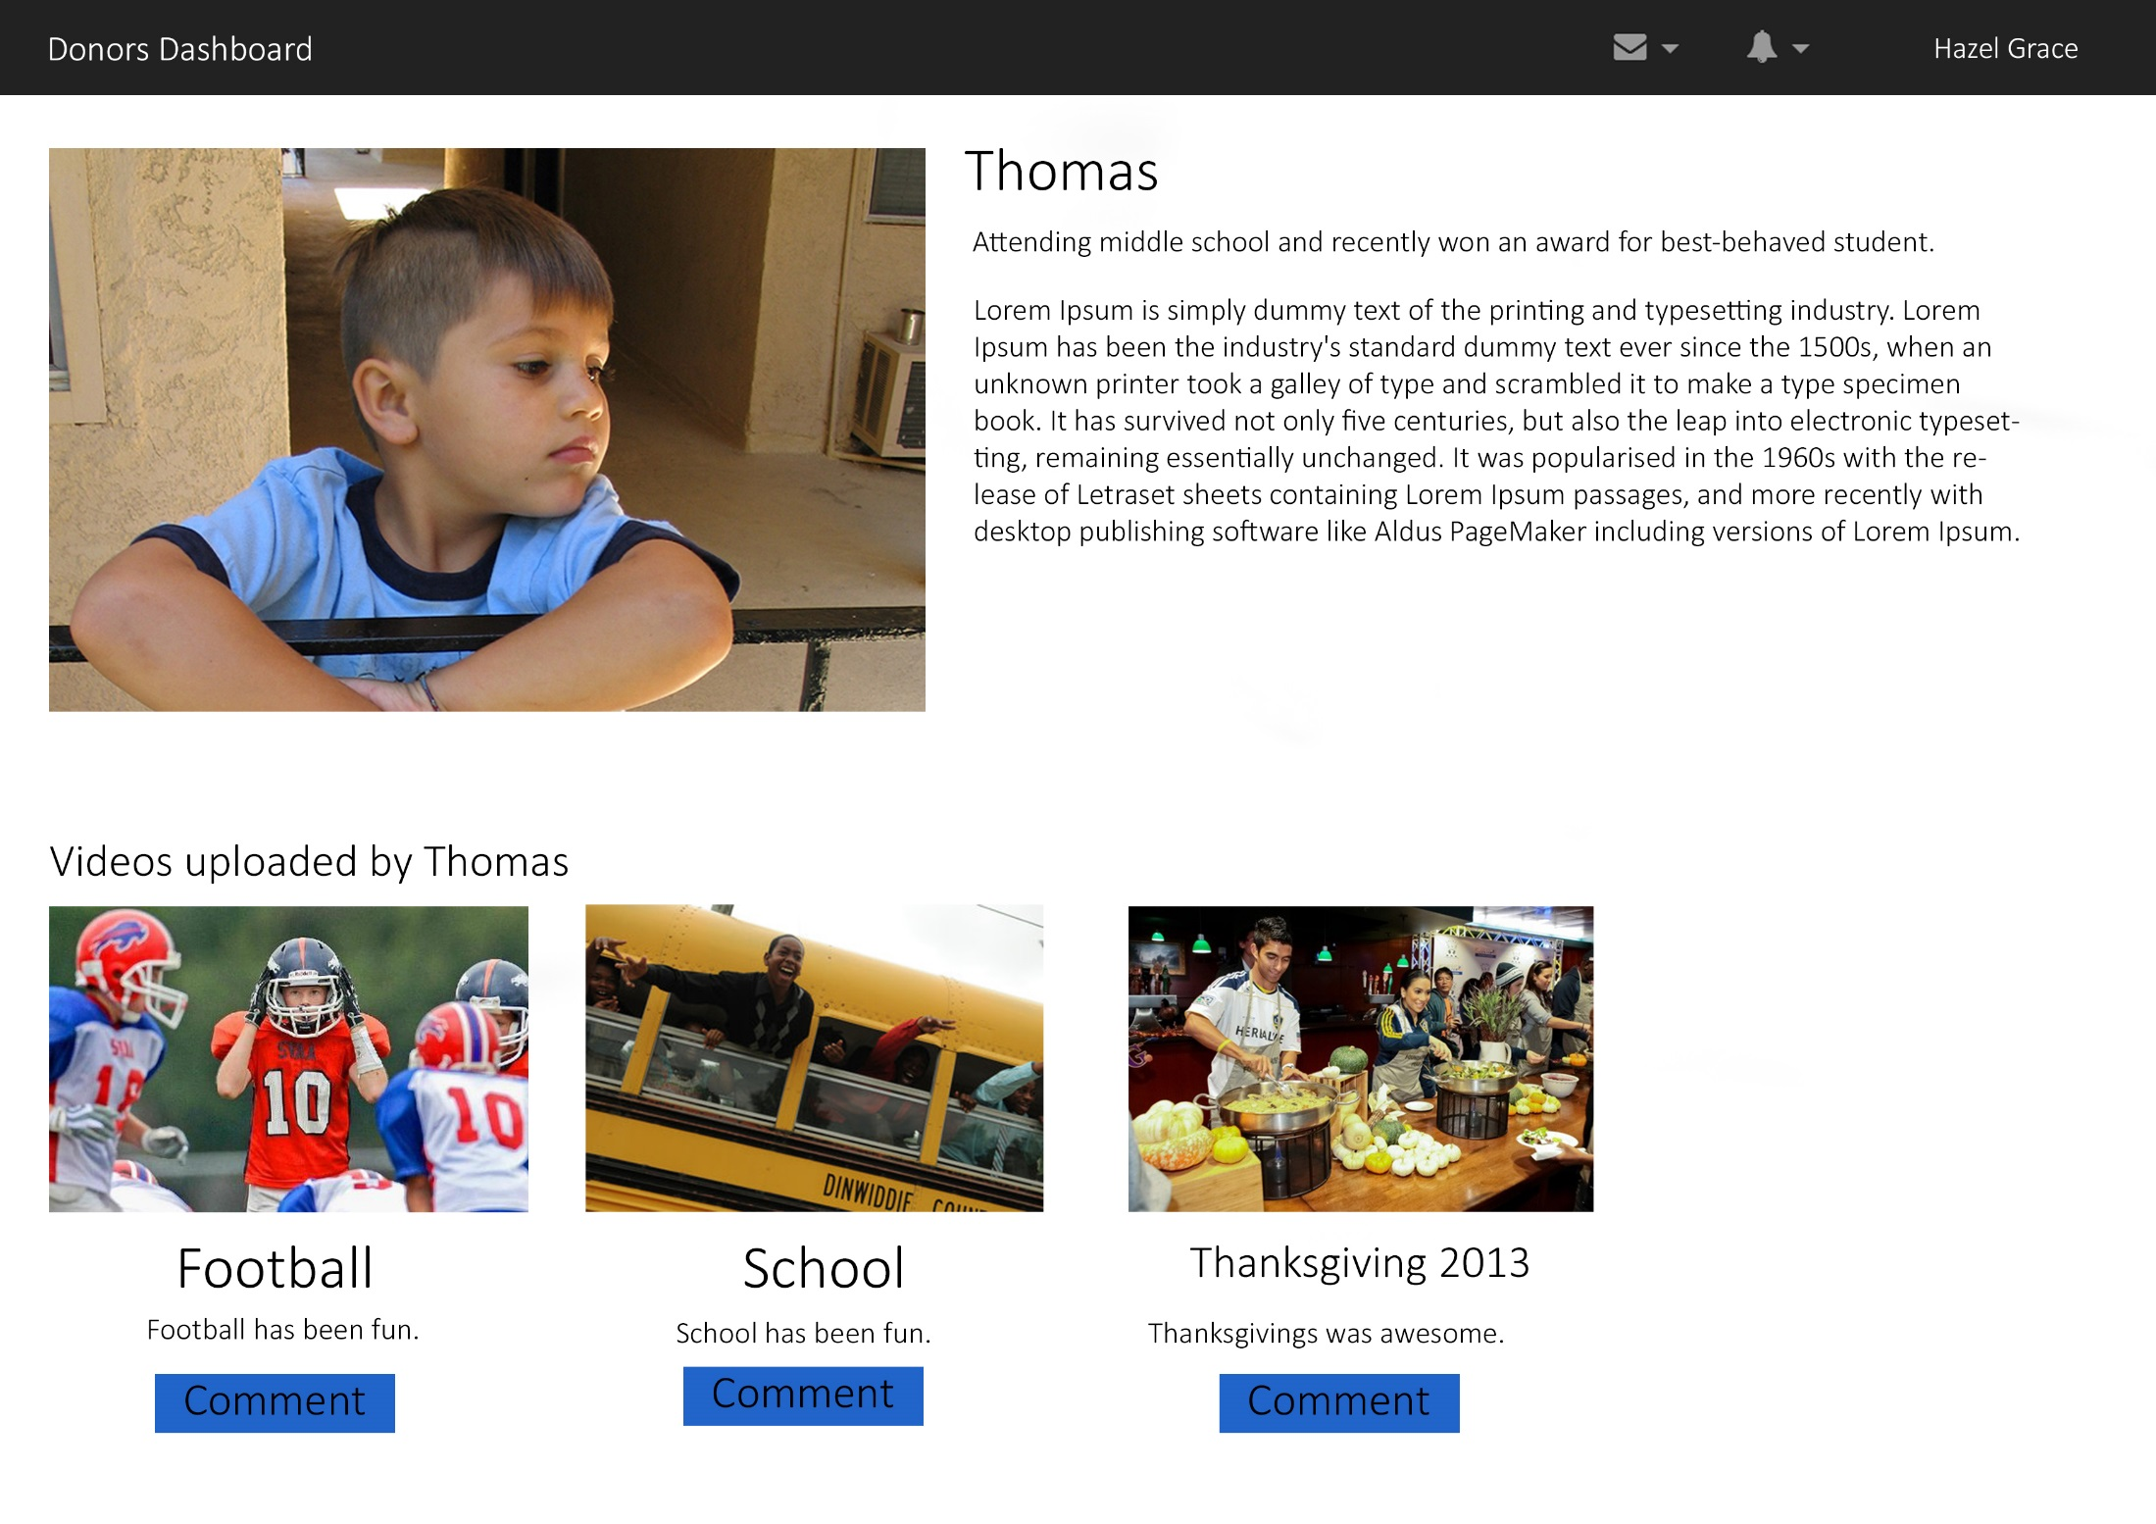

Slide 13
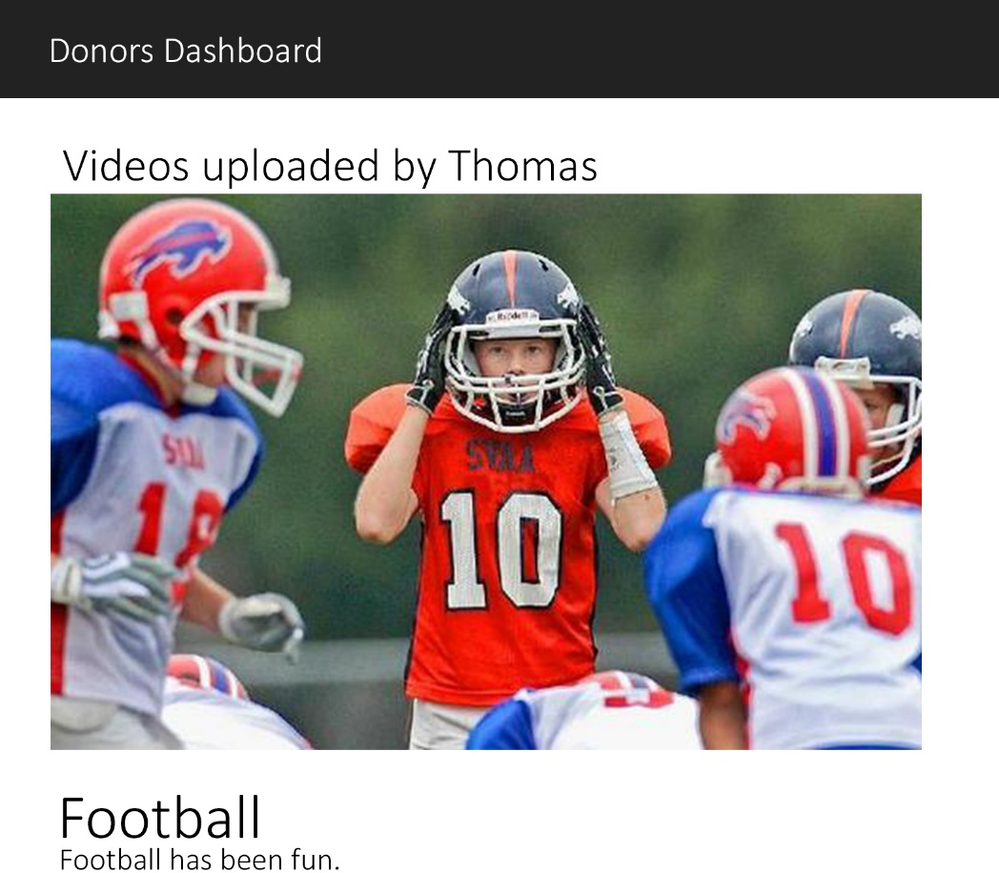
Post a video comment

Slide 14
Who use ABC’s In-Touch?
Donors
Children
Organization

Slide 15



Why use ABC’s In-Touch?
Safe and Regulated Content
Asynchronous
Exclusive ABC Community

Slide 16

In Touch

